Slide 1
Applied Natural Language Processing
Dr. Sucharitha Shetty

Slide 2
Course Outcomes
At the end of this course, students will be able to:
1. Understand the basic concepts and algorithms of natural language processing.
2. Apply neural networks for language modelling
3. Generate natural language and transform using machine learning models
4. Discover entity-emotions relationship through conflict resolution
5. Develop language models by integrating knowledge.

Slide 3
Why Natural Language Processing?
Humans communicate primarily through language
Vast amount of data is unstructured text (emails, reports, social media, research papers)
NLP enables machines to understand, interpret, and generate human language
Core to applications like chatbots, search engines, translation, summarization, QA systems

Slide 4
Some NLP Applications
finding appropriate documents on certain topics from a database of texts (for example, finding relevant books in a library)
extracting information from messages or articles on certain topics (for example, building a database of all stock transactions described in the news on a given day)
translating documents from one language to another (for example, producing automobile repair manuals in many different languages)
summarizing texts for certain purposes (for example, producing a 3-page summary of a 1000-page government report)

Slide 5
Some NLP Applications
question-answering systems, where natural language is used to query a database (for example, a query system to a personnel database)
automated customer service over the telephone (for example, to perform banking transactions or order items from a catalogue)
tutoring systems, where the machine interacts with a student (for example, an automated mathematics tutoring system)
spoken language control of a machine (for example, voice control of a VCR or computer)

Slide 6
Production-Level Applications
A computer program in Canada accepts daily weather data and
automatically generates weather reports in English and French
Over 1,000,000 translation requests daily are processed by the Babel Fish system available through Altavista
A visitor to Cambridge, MA can ask a computer about places
to eat using only spoken language. The system returns relevant information from a database of facts about the restaurant scene.

Slide 7
Prototype-Level Applications
Computers grade student essays in a manner indistinguishable from human graders
An automated reading tutor intervenes, through speech, when the reader makes a mistake or asks for help
A computer watches a video clip of a soccer game and produces a report about what it has seen
A computer predicts upcoming words and expands abbreviations to help people with disabilities to communicate

Slide 8
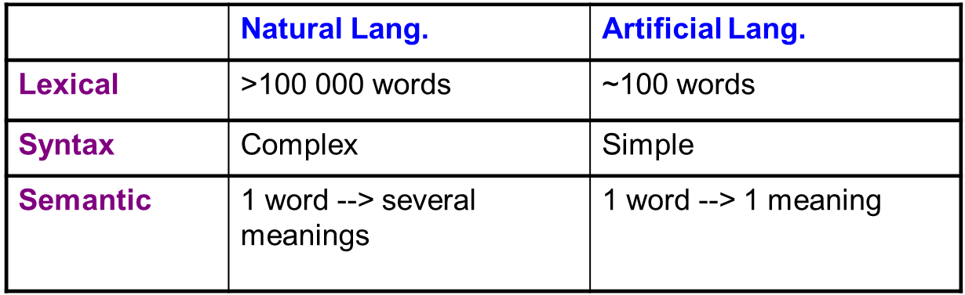
Background - Goal of NLP
Develop techniques and tools to build practical and robust systems that can communicate with users in one or more natural language

Slide 9
Background - Goal of NLP
1. Lexical Analysis
Breaks text into words or tokens
Normalizes words (e.g., running → run)
Example:
Sentence: “Cats are running”
Lexical output: cats / are / running
2. Syntactic Analysis
Analyzes grammatical structure
Checks how words are arranged
Example:
“Cats are running” → Subject (Cats) + Verb (are running)

Slide 10
Background - Goal of NLP
3. Semantic Analysis
Determines the actual meaning
Resolves ambiguity and relationships
Example:
Sentence:
“The chicken is ready to eat.”
Semantic ambiguity:
The chicken is cooked and ready to be eaten
The chicken is hungry and ready to eat food

Slide 11
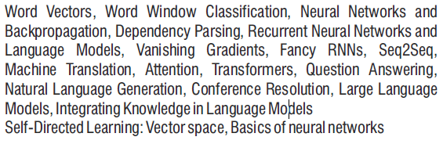
Detailed Syllabus Breakdown

Slide 12
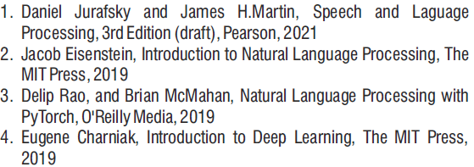
References

Slide 13
Foundation: Text as Data
We begin the course by understanding how language can be represented numerically, since machines can only process numbers.
Topics such as vector space models and word vectors explain how words and documents are mapped into mathematical spaces where similarity and meaning can be computed.
We also study word window classification, which introduces the idea of using local context to predict or classify words—this forms the basis for neural NLP models

Slide 14
Neural Networks for NLP
Once text representations are established, we move to neural networks and backpropagation.
This part of the syllabus focuses on:
How neural networks learn language patterns
How gradients are used to optimize models
Why neural models perform better than traditional machine learning for NLP tasks
These concepts serve as a foundation for all advanced NLP architectures.

Slide 15
Language as a Sequence
Human language is sequential because the order of words matters.
Changing the order of words often changes the meaning of a sentence.
Example:
“The dog chased the cat”
“The cat chased the dog”
Although the same words are used, the meaning is completely different because of sequence.
Traditional models like Bag-of-Words ignore word order, so they fail to capture this important property of language.

Slide 16
Language as a Sequence
To model this, we study Recurrent Neural Networks (RNNs) and language models, which process text word by word and learn dependencies across sequences.
We also address practical challenges such as the vanishing gradient problem and explore advanced RNN architectures like LSTMs and GRUs that overcome these limitations.

Slide 17
Sequence-to-Sequence Learning
The course then progresses to Seq2Seq models, which are essential for tasks where both input and output are sequences, such as machine translation and summarization.
To further improve performance, we study attention mechanisms, which allow models to focus on relevant parts of the input, leading to more accurate and interpretable predictions.

Slide 18
Transformers and Modern NLP
A major focus of this course is on transformer architectures, which have revolutionized NLP.
Transformers form the backbone of:
BERT
GPT
Large Language Models (LLMs)
We study how transformers work, why they scale efficiently, and how they outperform earlier models.

Slide 19
Coreference Resolution
Simple Explanation (for class)
In natural language, the same entity is often referred to in multiple ways.
For example:
“Ravi went to the conference. He presented his paper.”
Here, “Ravi” and “He” refer to the same person.
Coreference resolution is the task of automatically detecting and linking such references.

Slide 20
Large Language Models and Knowledge Integration
Towards the end of the course, we focus on Large Language Models and the challenge of integrating external knowledge into language models

Slide 21
Large Language Models and Knowledge Integration
Aspect | Large Language Models (LLMs) | Knowledge-Integrated Language Models
Core Idea | Learn language patterns from large text data | Combine language models with external knowledge
Knowledge Source | Implicit knowledge from training data | Explicit structured or retrieved knowledge
Accuracy | May generate incorrect or hallucinated facts | Improved factual correctness
Knowledge Update | Static (fixed after training) | Dynamic (knowledge can be updated)
Reasoning Ability | Limited reasoning | Better reasoning using knowledge bases
Explainability | Low | Higher due to explicit knowledge
Domain Adaptation | General-purpose | Strong in domain-specific tasks
Examples | GPT, BERT, T5 | RAG-based systems, Knowledge-augmented LLMs

Slide 22
Thank You

